Slide 1
Galaxy:
A High-Performance Energy-Efficient Multi-Chip Architecture Using Photonic Interconnects
Nikos Hardavellas
PARAG@N – Parallel Architecture Group
Northwestern University
Team: Y. Demir, P. Yan, S. Song, J. Kim, G. Memik

Slide 2
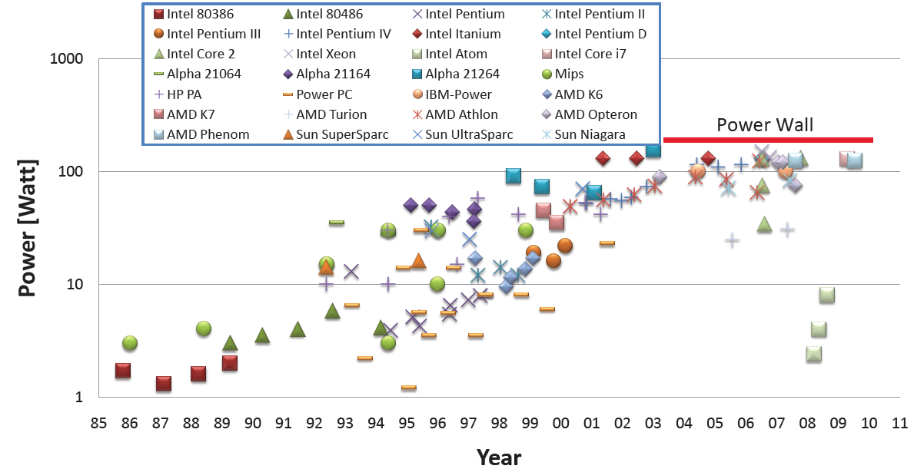
Technology Scaling Runs Out of Steam
Transistor counts increase exponentially, but…
Can no longer power the entire chip
(voltage, cooling do not scale)
Can no longer feed all cores
with data fast enough
(package pins do not scale)
Power
Wall
Bandwidth
Wall
Can no longer keep costs at bay
(process variation, defects)
Monolithic (single-chip) processor
designs running out of steam too
Low Yield
Notes:
580 mm2 die: 25600 pins to package at 150μm 5x5 cm: 3844 substrate-to-board at 0.8m.
1.2V 100nm -> 0.85V 28nm

Slide 3
Demand for High-Performance Computing Grows
SPEC, TPC datasets growth: faster than Moore
Same trends in scientific, personal computing
Large Hadron Collider
  March’11: 1.6PB data (Tier-1)
Large Synoptic Survey Telescope
  30 TB/night
  2x Sloan Digital Sky Surveys/day
    Sloan: more data than entire history of astronomy before it
More data → more computing power to process them

Slide 4
Galaxy: Optically-Connected Disintegrated Processors
[WINDS 2010, ICS 2014]
Physical constraints limit single-chip designs
  Area, Yield, Power, Bandwidth
Multi-chip designs break free of these limitations
  Processor disintegration
  Macro-chip integration

Slide 5
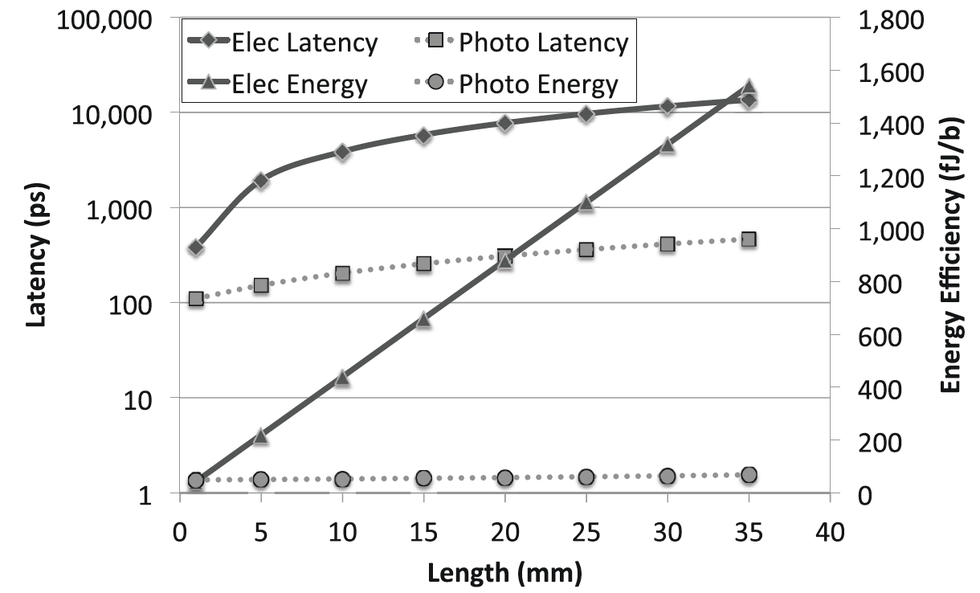
Electrical vs. Photonic Links
[Nitta et al., 2013]

Slide 6
Outline
Introduction
➔ Background
Galaxy Architecture
Experimental Methodology
Results
  Sensitivity Studies
  Single-Chip Comparisons (Processor Disintegration)
  Multi-Chip Comparisons (Macrochip Integration)
  Thermal Modeling
Conclude

Slide 7
Nanophotonic Components
resonant
detectors
Ge-doped
coupler
waveguide
off-chip
laser source
resonant modulators
Selective: couple optical energy of a specific wavelength

Slide 8
Modulation and Detection
10001011
11010101
  16 - 64 wavelengths DWDM
  5 - 20μm waveguide pitch
  10Gbps per link
10001011
11010101

Slide 9
Outline
Introduction
Background
➔ Galaxy Architecture
Experimental Methodology
Results
  Sensitivity Studies
  Single-Chip Comparisons (Processor Disintegration)
  Multi-Chip Comparisons (Macrochip Integration)
  Thermal Modeling
Conclude

Slide 10

Optical Crossbar

Slide 11
Routing Example

Slide 12
Single Chiplet Connectivity

Slide 13
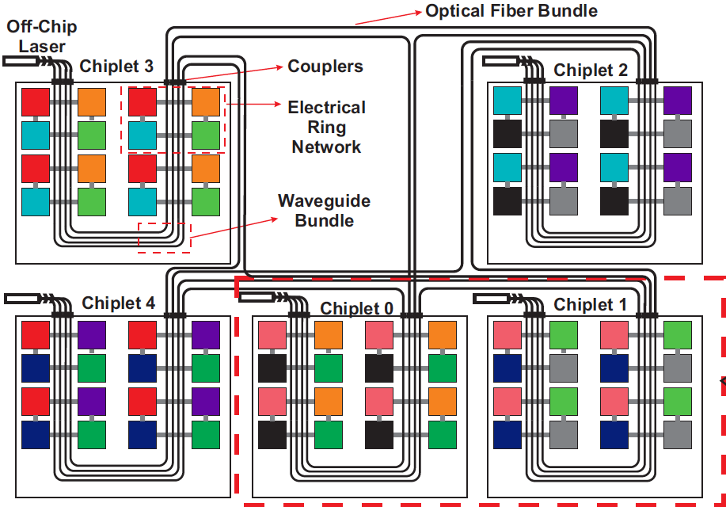
Galaxy Architecture (5-chiplet example)
Notes:
200mm² die, 128 cores/chiplet, 9 chiplets, 16cm fiber: > 1K cores
256 cores/chiplet, 17 chiplets: > 4K cores
10 radix-8 MWSR crossbars, 64bit flits,16-way DWDM, data: 320 fibers 40960 rings, arb: 20 fibers 3840 rings, fwd clock: 10 fibers 80 rings

Slide 14
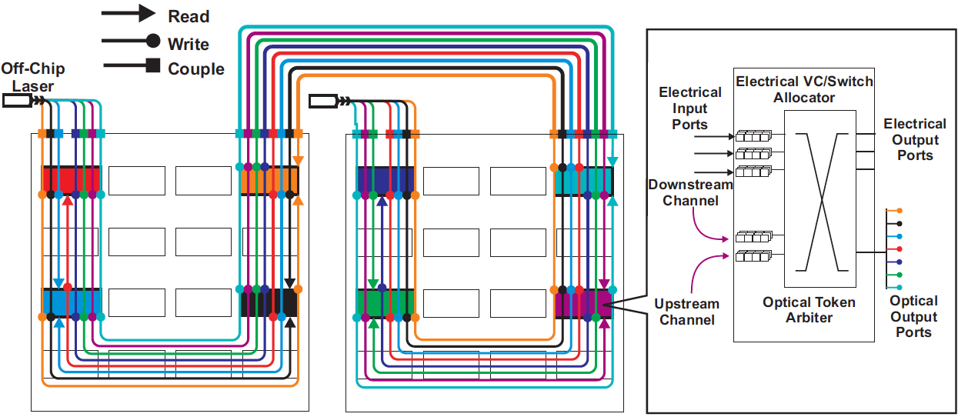
Galaxy MWSR Optical Crossbar
MWSR avoids broadcast data bus, but requires arbitration

Slide 15
Why Fibers and not SOI Waveguides?
Almost twice as fast: 0.286c vs 0.676c
Negligible optical loss: 0.3db/cm vs. 0.2db/Km
Fibers are flexible → do not restrict the design to a 2D plane
  Minimize thermal transfer → cheap cooling
Overlooked due to density concerns
  Fibers at 250um pitch
  Waveguides at 20um pitch

Slide 16
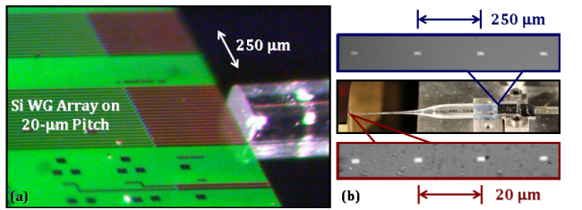
Dense Off-Chip Coupling
Dense optical fiber array [Lee, OSA/OFC/NFOEC 2010]
~3.8dB loss, 8 Tbps/mm demonstrated
Misalignment within <0.7μm, 0.4μm, 0.7μm> → loss <1 dB
Loss comparable to optical proximity couplers
Notes:
116 mm2 chiplets → 43mm in length along the chip edge → 172 fibers at 250 um

Slide 17
Outline
Introduction
Background
Galaxy Architecture
➔ Experimental Methodology
Results
  Sensitivity Studies
  Single-Chip Comparisons (Processor Disintegration)
  Multi-Chip Comparisons (Macrochip Integration)
  Thermal Modeling
Conclude

Slide 18
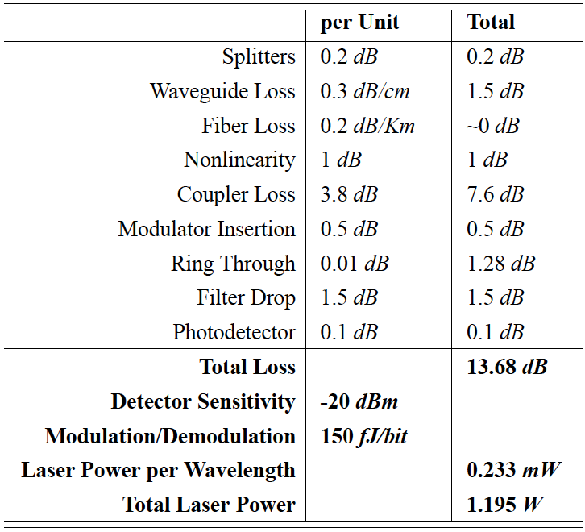
Nanophotonic Parameters
Notes:
mod/demodulation energy 150 fJ/bit @ 10 GHz
power generation & delivery typically excluded. Additional coupling loss → 2.9W. 25% efficiency → wall-socket power 12W

Slide 19
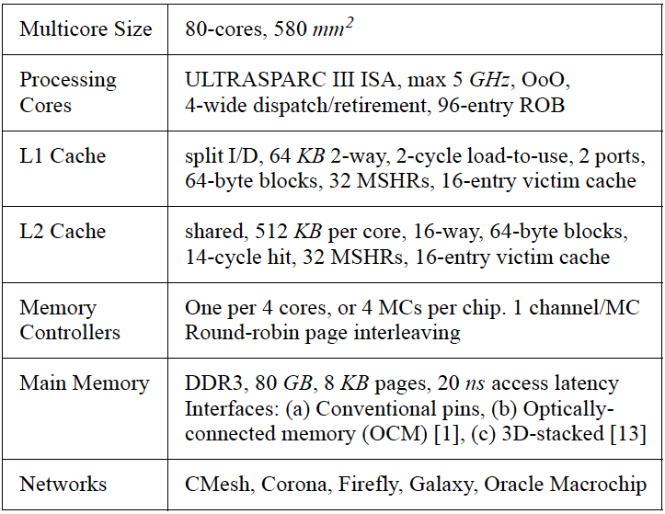
Architectural Parameters
Notes:
Corona: 256-wide data channels, 80 crossbars, 16cm WG
10ns OCM, 2ns 3D-mem

Slide 20
Modeling Infrastructure
SimFlex sampling
95% confidence
photonic-layer
ring heating
3D-stack model
Notes:
target: 16nm node
Workloads: SPLASH and scientific

Slide 21
Outline
Introduction
Background
Galaxy Architecture
Experimental Methodology
Results
  ➔ Sensitivity Studies
  Single-Chip Comparisons (Processor Disintegration)
  Multi-Chip Comparisons (Macrochip Integration)
  Thermal Modeling
Conclude

Slide 22
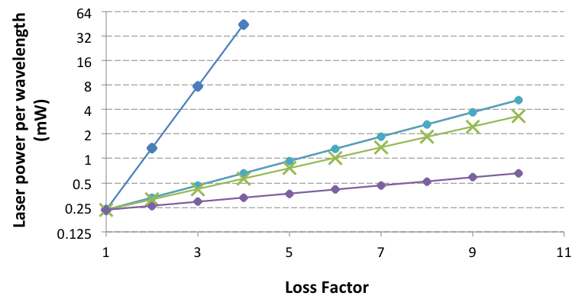
Laser Power Sensitivity to Optical Parameters
Coupler Loss
Waveguide & Filter Drop Loss
Off-Ring Loss
Modulator Insertion Loss
Highly sensitive to coupler loss, insensitive to other losses

Slide 23
Sensitivity to Fiber Density
116mm² chiplets → 43mm along the chip edge
Enough room for 172 fibers @ 250μm pitch
128 fibers: within 3% of max performance

Slide 24
Outline
Introduction
Background
Galaxy Architecture
Experimental Methodology
Results
  Sensitivity Studies
  ➔ Single-Chip Comparisons (Processor Disintegration)
  Multi-Chip Comparisons (Macrochip Integration)
  Thermal Modeling
Conclude

Slide 25
Performance Against “Unlimited” Designs
Speedup of (power+bandwidth)-constrained design
Speedup of bandwidth-constrained design
Speedup of power-constrained design
Speedup of unconstrained design
Galaxy matches the performance of “unlimited” designs

Slide 26
Performance Against “Unlimited” Designs
Speedup of (power+bandwidth)-constrained design
Speedup of power-constrained design
Speedup of bandwidth-constrained design
Speedup of unconstrained design
Galaxy matches the performance of “unlimited” designs

Slide 27
Performance Against “Realistic” Designs
Realistic: within power and bandwidth envelopes
Galaxy chiplets within 66.2ºC → chiplets run at max speed
Galaxy: 2.4x - 3.2x speedup on average (3.4 max)

Slide 28
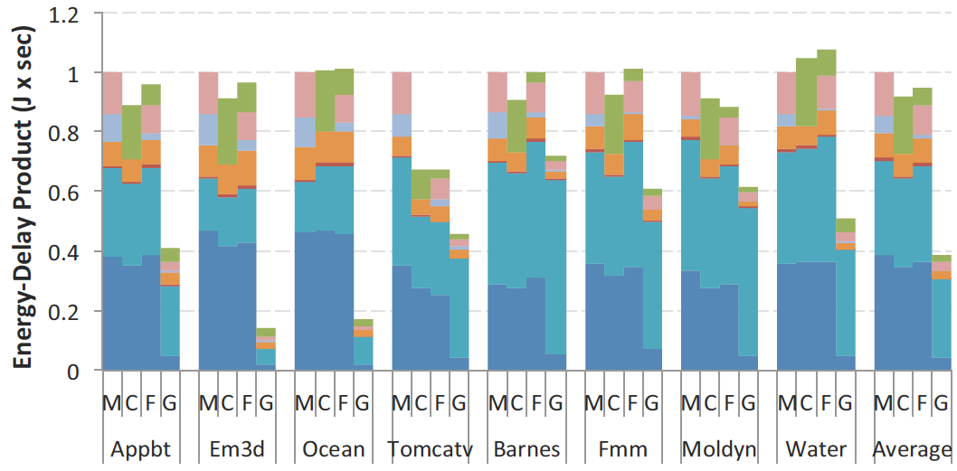
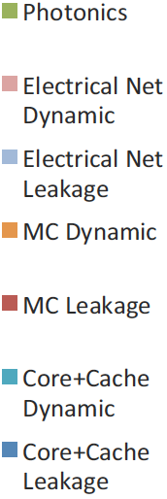
Energy-Delay Product
Galaxy: 2.4x-2.8x smaller EDP on average (7.1x max)

Slide 29
Outline
Introduction
Background
Galaxy Architecture
Experimental Methodology
Results
  Sensitivity Studies
  Single-Chip Comparisons (Processor Disintegration)
  ➔ Multi-Chip Comparisons (Macrochip Integration)
  Thermal Modeling
Conclude

Slide 30
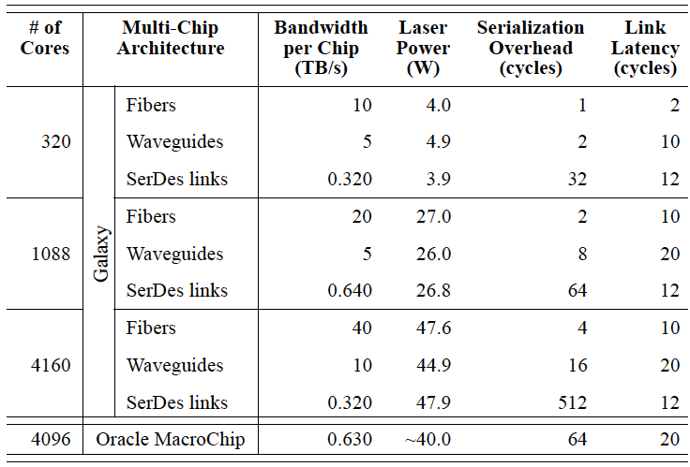
Comparison Against Multi-Chip Alternatives
Notes:
SerDes on FR-4 incurs significant energy consumption or long delays (20 pJ/bit typically, and at best 2.5 pJ/bit and 2.5 ns latency over 4 inches of electrical strip)

Slide 31
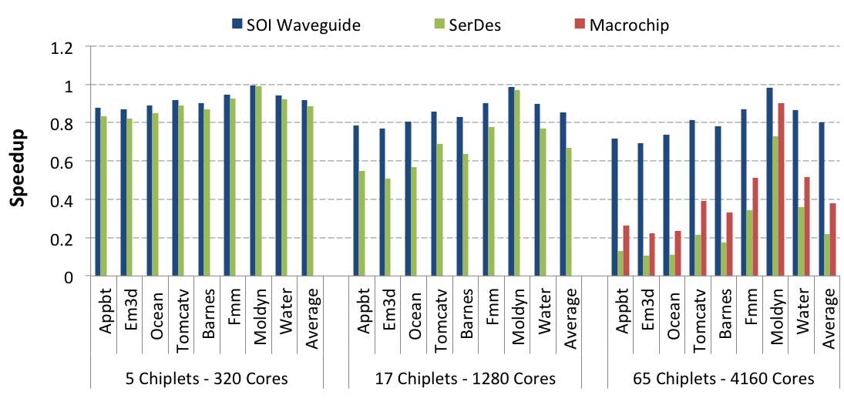
Comparison Against Multi-Chip Alternatives
Fiber
Galaxy: 2.5x speedup over Oracle Macrochip (6.8x max)
6x less laser power with demonstrated couplers
Notes:
WG: 1.25x

Slide 32
Outline
Introduction
Background
Galaxy Architecture
Experimental Methodology
Results
  Sensitivity Studies
  Single-Chip Comparisons (Processor Disintegration)
  Multi-Chip Comparisons (Macrochip Integration)
  ➔ Thermal Modeling
Conclude

Slide 33
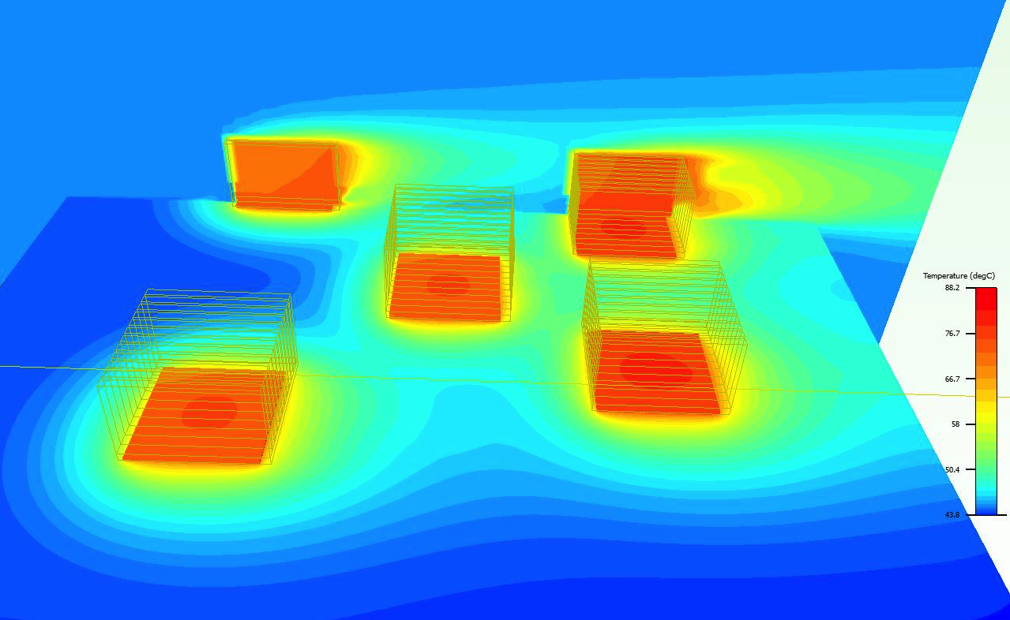
80-core 5-chiplet Galaxy Thermal CFD Modeling
88.2⁰C
8cm spacing allows cooling with cheap passive heatsinks
Notes:
88.2C, 8cm, 45C ambient

Slide 34
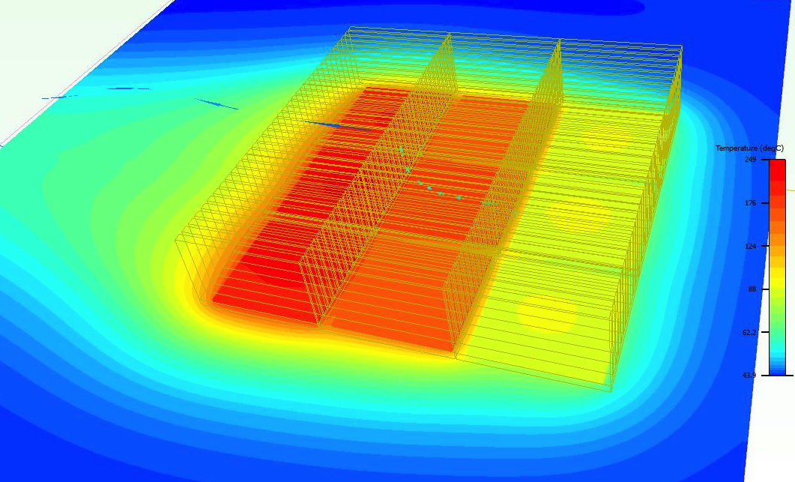
9-chiplet Dense Array (Oracle Macrochip)
249⁰C
Tight arrangement points to liquid cooling requirement
Notes:
249C

Slide 35
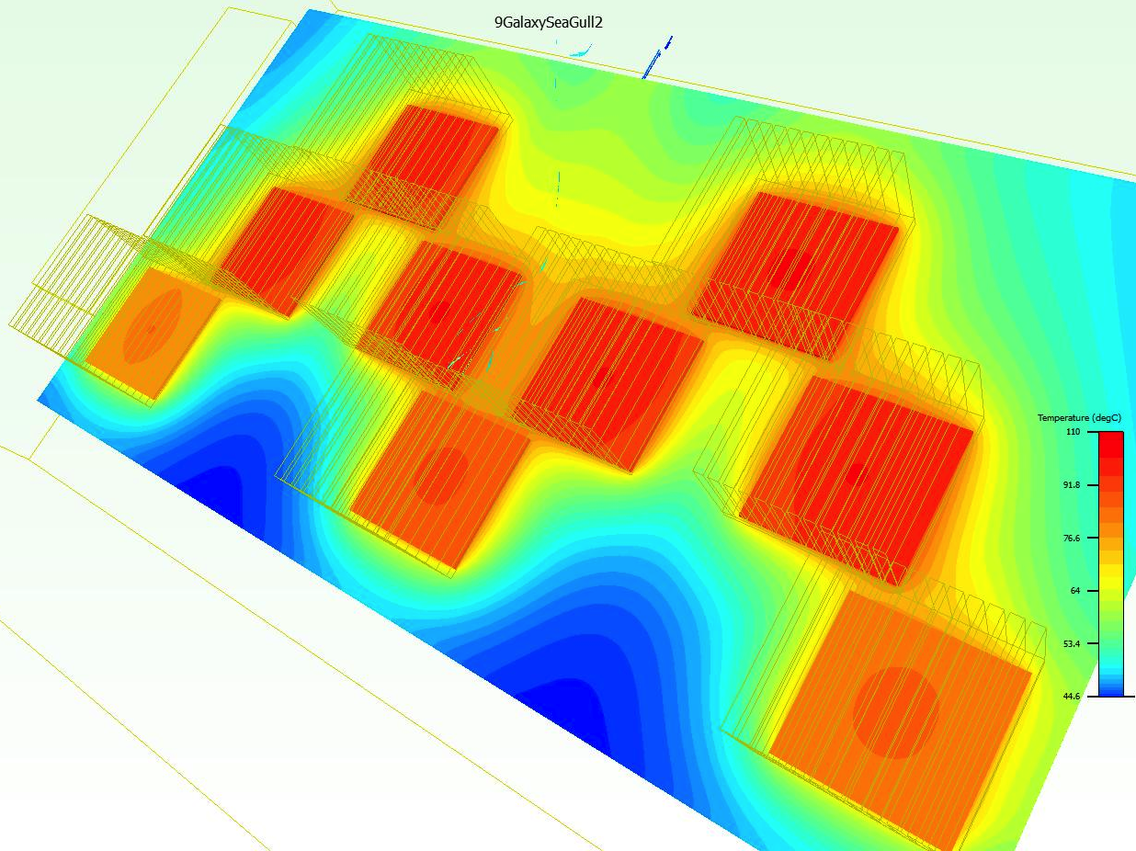
9-chiplet Galaxy 2D
110⁰C
Cooling 9 chiplets with passive heatsinks
Notes:
110C

Slide 36
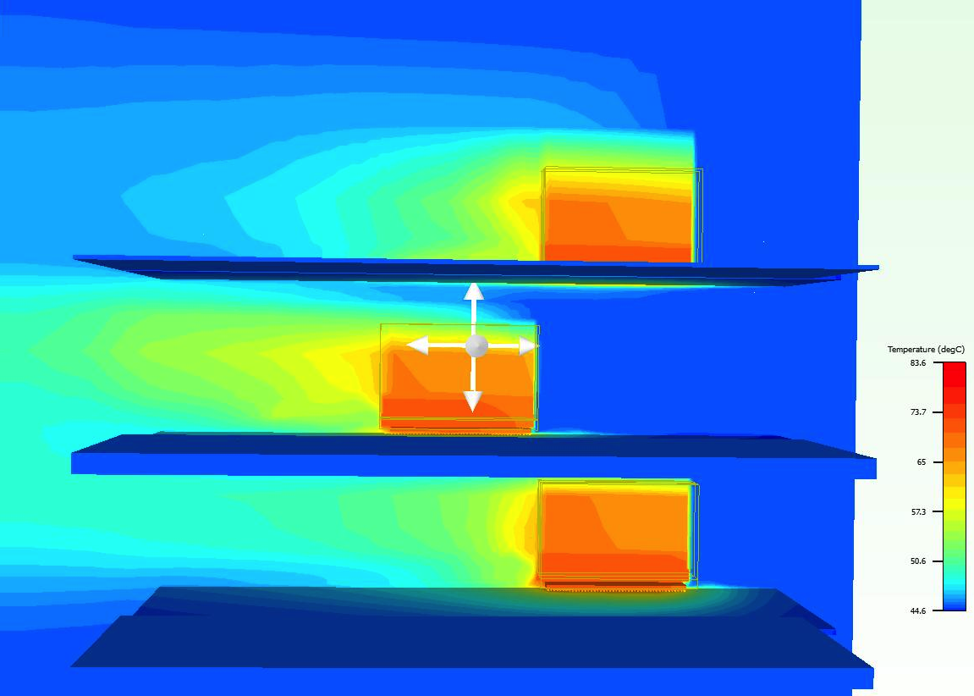
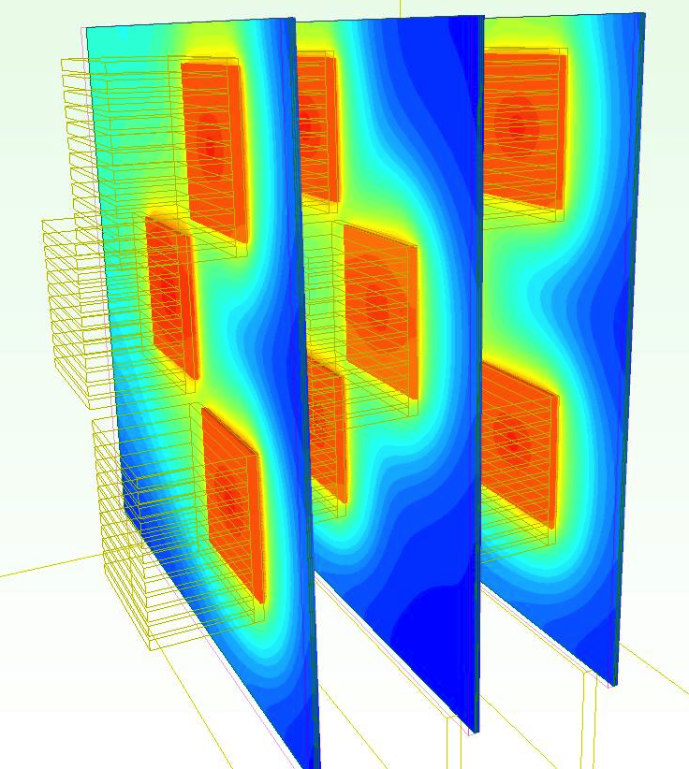
9-chiplet Galaxy 3D
83.6⁰C
Flexible fibers allow “virtual chip” to break free of 2D planar designs
Notes:
83.6C

Slide 37
Galaxy Summary
“Virtual chips” with the performance of unlimited designs
Breaks free of typical physical constraints
  Large aggregate area
  Improved yield (break-even point : 60% yield for photonics)
  Tb/s/mm bandwidth density
  Pushes back power wall
Processor disintegration
  2.4x – 3.2x avg. speedup (3.4 max)
  2.4x – 2.8x avg. smaller EDP (7.1x max)
Macrochip integration
  2.5x speedup over Oracle Macrochip (6.8x max)
  6x more power efficient links

Slide 38
High Laser Wall-Plug Power
Laser power consumption is generally high
  High optical loss components
    Galaxy restricts sharers of an optical path to at most 8
    High-radix crossbars are impractical
      Radix-16 MWSR: 20.1W
      Radix-64 MWSR: 78.1W
    Coupling the off-chip laser on chip: 2.4x power loss (3.8 dB)
  WDM-compatible lasers: 5-10% efficiency
What if we can power-gate the laser?
  Off-chip lasers: long latencies (10-16ns)
  On-chip Ge-doped lasers: 1ns on/off delay

Slide 39
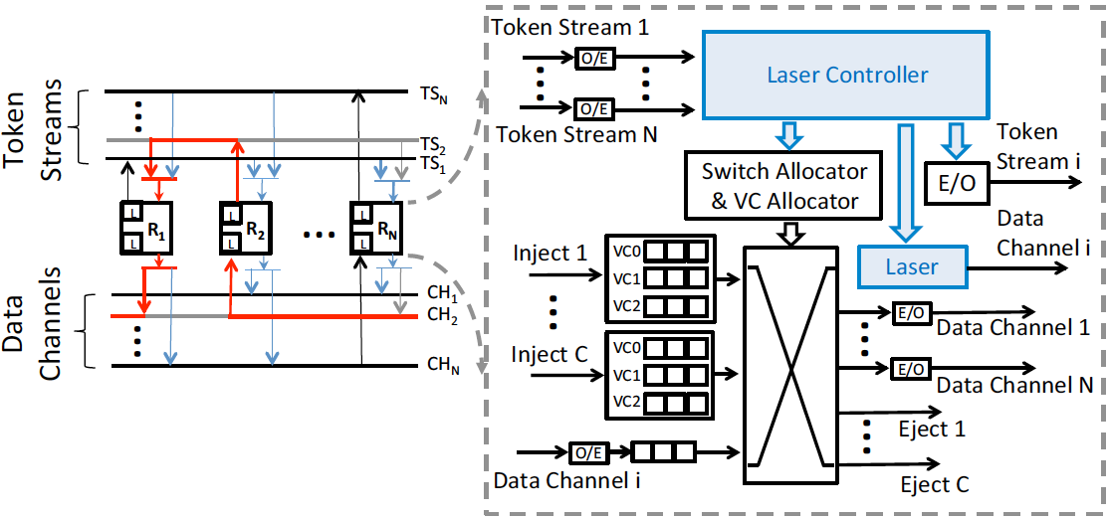
EcoLaser MWSR Crossbar and Router Architecture

Slide 40
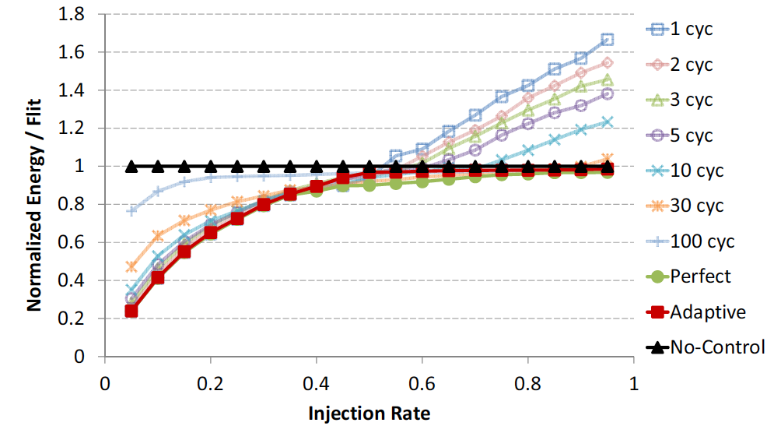
EcoLaser Energy/Flit for Radix-16 MWSR

Slide 41
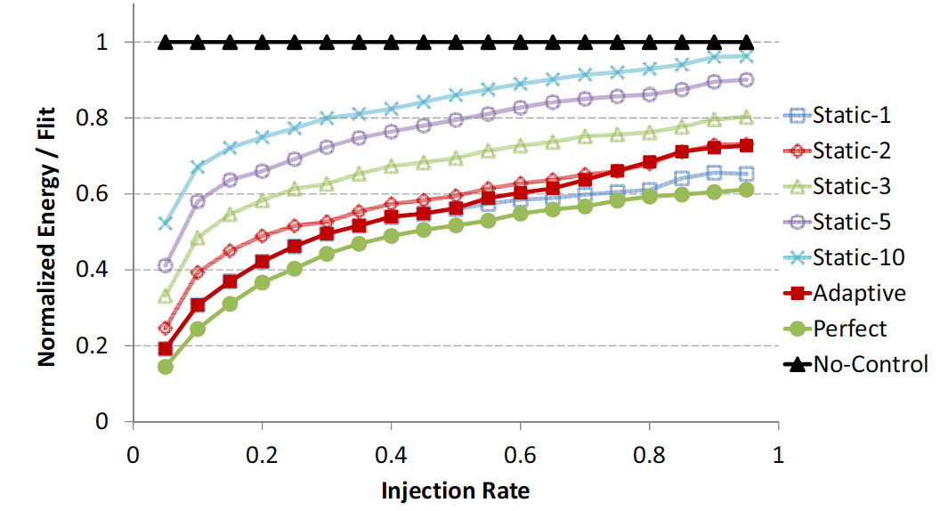
EcoLaser + AdaptiveWidth for Radix-16 SWMR
EcoLaser power savings → higher power budget for cores → 2x speedup

Slide 42
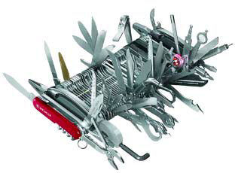

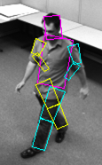
Thank You!
PARAG@N: Energy-Efficient Computing
Galaxy: nanophotonics to overcome
physical single-chip limitations [WINDS’10, ICS’14]
  Processor disintegration, macrochip integration
  Arch/nanophotonics intersection
    SeaFire: Design for Dark Silicon [IEEE Micro’11, USENIX-Login’11]
  We cannot power up an entire chip
  Heterogeneous/specialized designs
Elastic Fidelity [CoRR abs/1111.4279]
  Some errors are ok
  Allow a few errors to make computers power efficient
Elastic Caches [ISCA’09, IEEEMicro’10, DATE’12, IEEE Computer’13]
  Dynamically adapt on-chip storage to workload requirements
Notes:
disciplined

Slide 43
Thank You!

Slide 44
BACKUP SLIDES

Slide 45
Chip Power Scaling
[Azizi 2010]
Chip power does not scale

Slide 46
Voltage Scaling Has Slowed
  In last decade: 13x transistors but 30% lower voltage
  Cannot run all transistors fast enough
Notes:
1.2V -> 0.85V
100nm -> 28nm

Slide 47
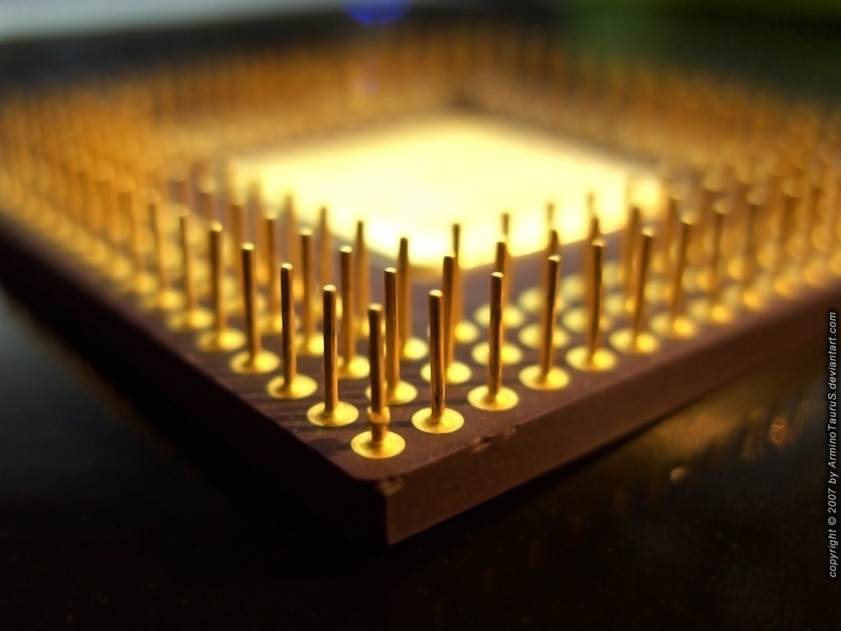
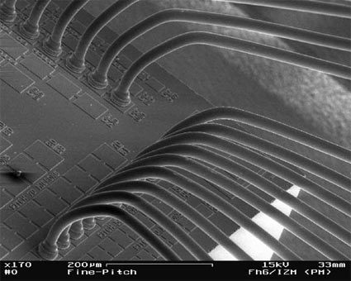
Pin Bandwidth Scaling
[TU Berlin]
Cannot feed cores with data fast enough to keep them busy
Notes:
580 mm2 die: 25600 pins to package at 150μm
5x5 cm: 3844 substrate-to-board at 0.8mm

Slide 48
Electrical (SerDes) vs. SOI Waveguides vs. Fibers

Slide 49
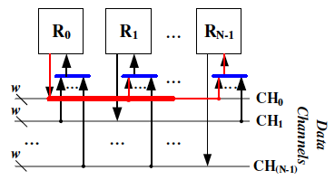
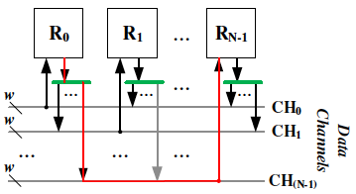
SWMR vs. MWSR Crossbar
Single-Writer Multiple-Reader
Broadcast bus
All receivers always read
On-rings → optical loss
High laser power
Multiple-Writer Single-Reader
Only one receiver reads
Only one ring is on → low loss
Low laser power
Needs arbitration

Slide 50
Token-Based Arbitration
8 cycles on average for token arbitration (5 chiplets)

Slide 51
Load Latency (uniform random traffic)

Slide 52
Load-Latency Curves
16 tokens provide optimal buffer depth
Notes:
Buffer depth → 16 tokens
Congested traffic: 72% utilization, 0.18 per-router injection rate

Slide 53
Tapered vs. Optical Proximity Couplers
6x less laser power than Oracle Macrochip with demonstrated couplers

Slide 54
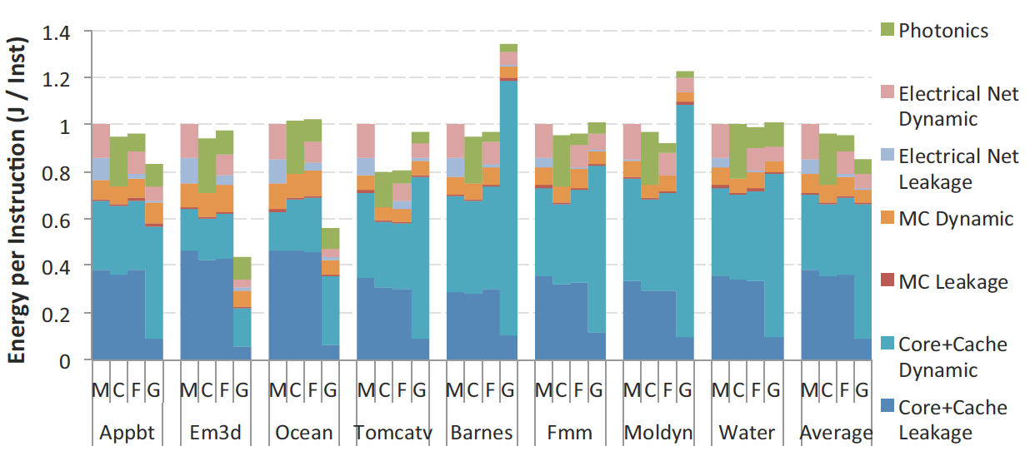
Energy per Instruction
Galaxy: 12-20% lower energy/instruction on average (up to 2.3x less)

Slide 55
EcoLaser Backup

Slide 56
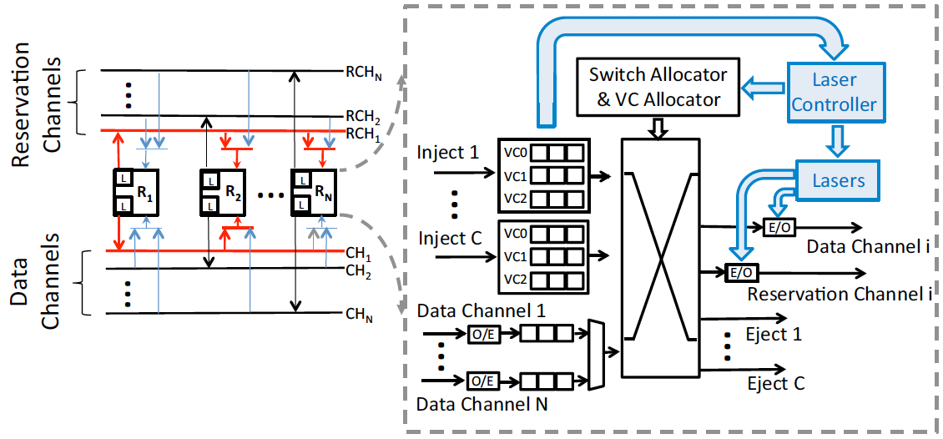
EcoLaser SWMR Crossbar and Router Architecture

Slide 57
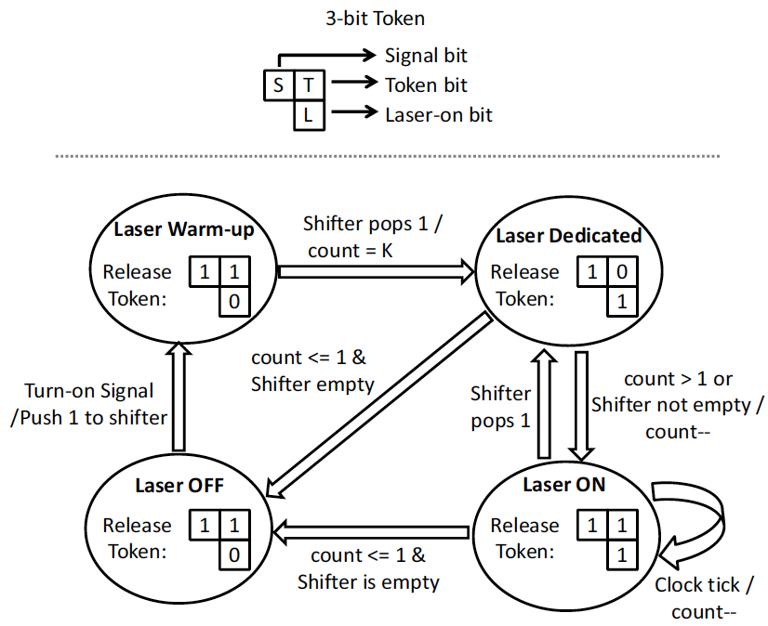
EcoLaser 3-bit Token and Laser Controller FSM

Slide 58
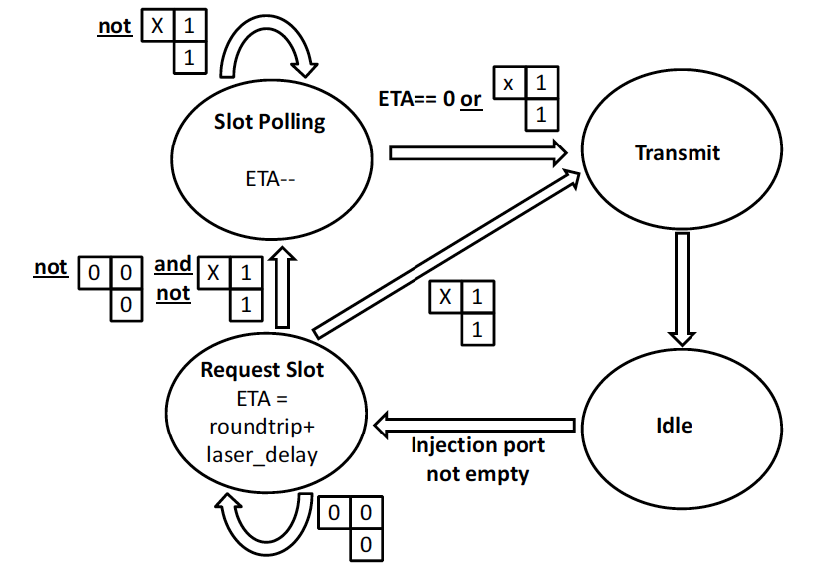
EcoLaser Writer Node FSM

Slide 59
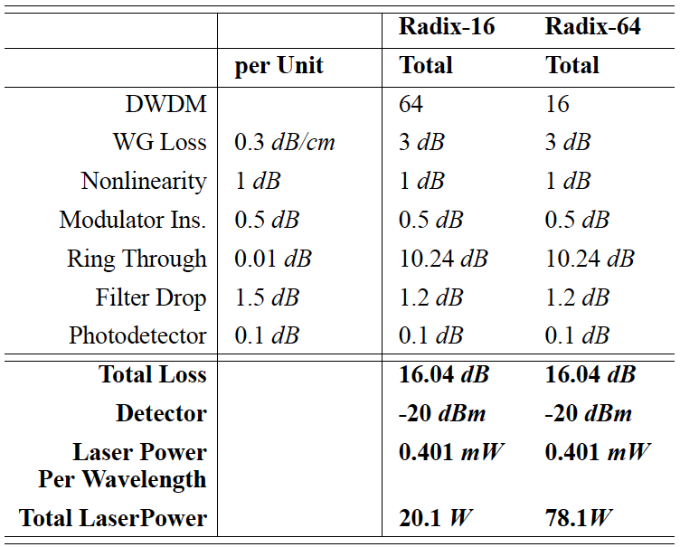
EcoLaser Nanophotonic Parameters

Slide 60
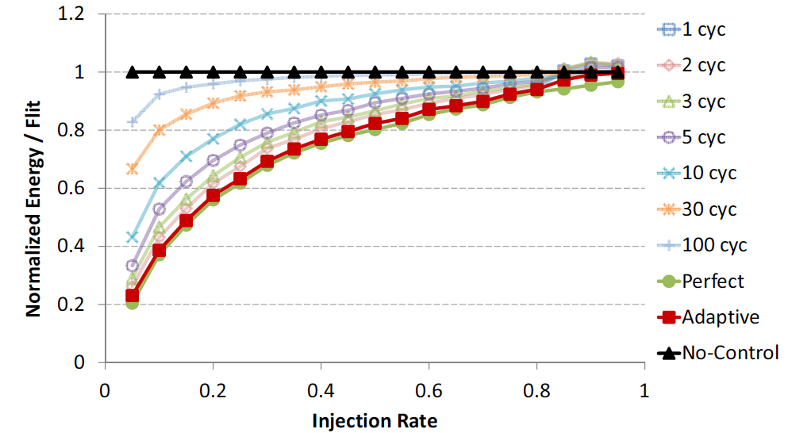
EcoLaser Energy/Flit for Radix-16 SWMR

Slide 61
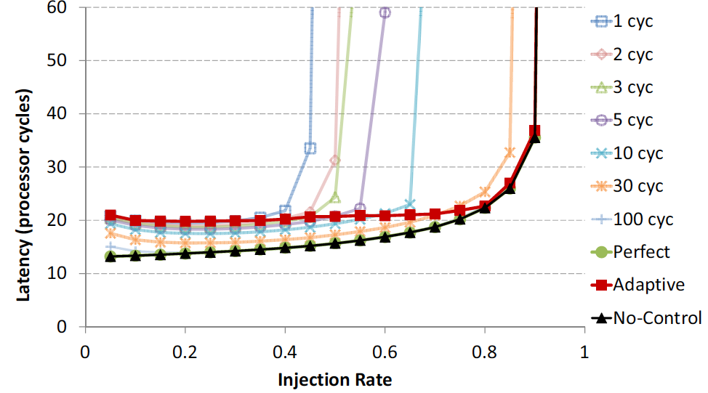
EcoLaser Latency Impact on Radix-16 MWSR

Slide 62
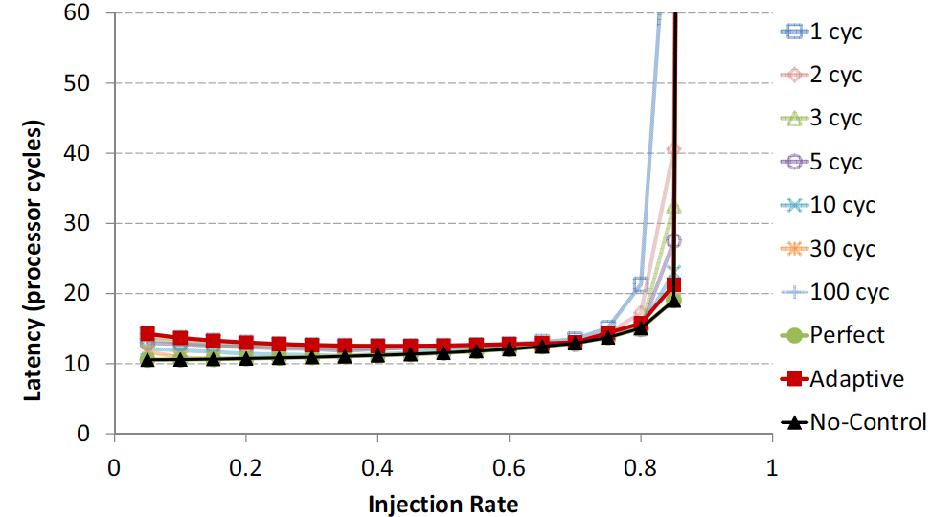
EcoLaser Latency Impact on Radix-16 SWMR

Slide 63
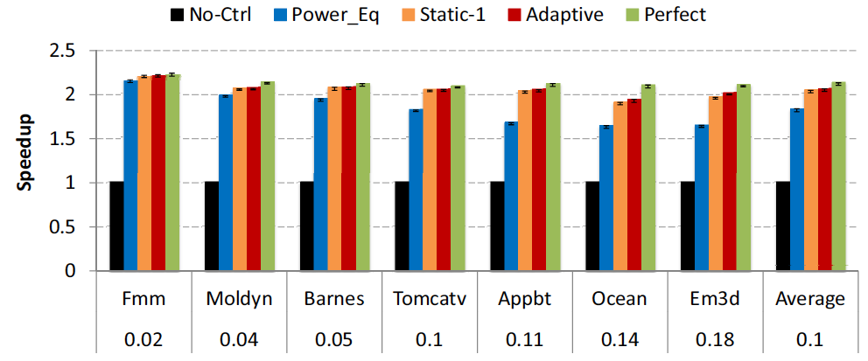
EcoLaser Speedup for Radix-64 SWMR
EcoLaser Power Savings → ~2x Speedup

Slide 64
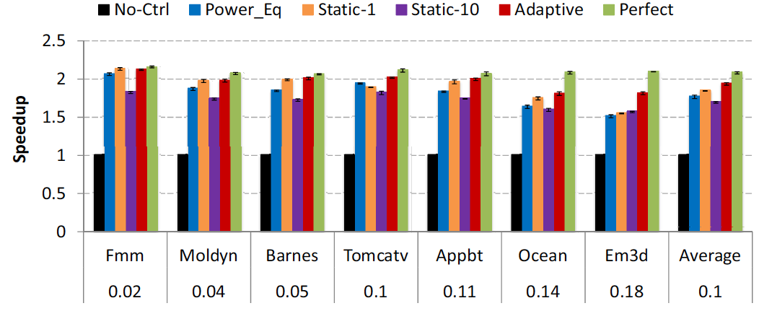
EcoLaser Speedup for Radix-64 MWSR
EcoLaser Power Savings → ~2x Speedup

