Slide 1
The Rise of Dark Silicon
Nikos Hardavellas
Northwestern University, EECS

Slide 2
Energy is Shaping the IT Industry
#1 of Grand Challenges for Humanity in the Next 50 Years
[Smalley Institute for Nanoscale Research and Technology, Rice U.]
A 1,000m² datacenter is 1.5MW!
Datacenter energy consumption in US >100 TWh in 2011 [EPA]
  2.5% of domestic power generation, $7.4B
Global computing consumed ~408 TWh in 2010 [Gartner]
Carbon footprint of world’s data centers ≈ Czech Republic
CO₂-equiv. emissions of US datacenters ≈ Airline Industry (2%)
  10% annual growth on installed computers worldwide [Gartner]
Exponential increase in energy consumption
Notes:
Modern computing consumes an inordinate amount of energy. [[Read examples from slides]]. And with a 10% expected annual growth on installed computers, these figures are bound to rise and negatively impact the economics and environmental footprint of computing. But the energy doesn’t grow only as a function of installed systems.

Slide 3
Application Dataset Scaling
Application datasets scale faster than Moore’s Law!
Notes:
Datasets are also scaling exponentially in time. They actually grow faster than Moore’s law.

Slide 4
Datasets Grow Exponentially
SPEC and TPC datasets grow faster than Moore’s Law
Large Hadron Collider
  March 2011: 1.6PB data produced and transferred to Tier-1
Large Synoptic Survey Telescope
  Produces 30 TB/night
  Roughly equivalent to 2 Sloan Digital Sky Surveys daily
    Sloan produced more data than entire history of astronomy before it
Massive data require massive computations to process them
Exponential increase in energy consumption
Notes:
These massive data require commensurate computational power to process them

Slide 5
Exponential Growth of Core Counts
Does performance follow same curve?
Notes:
Nowadays, these data are processed on multicore processors. The number of cores on these systems is also growing exponentially (for now). Popular belief holds that as cores grow, so does performance. However, this belief is just plain wrong.

Slide 6
Performance Expectations vs. Reality
Physical constraints limit speedup
Notes:
While people may expect performance to grow following Moore’s Law (blue line), in reality we observe a much slower performance growth (red line). The culprit here is that chips are physically constrained by bandwidth, power and thermal limits.

Slide 7
Pin Bandwidth Scaling
Cannot feed cores with data fast enough
Notes:
The bandwidth of off-chip pins grows slowly . As a result cores may starve for data, because we cannot feed them fast enough.

Slide 8
Supply Voltage Scaling
Cannot power up all transistors simultaneously → Dark Silicon
Notes:
In last decade: 10x transistors but 30% lower voltage. To power up all transistors we need exponential power, which we simply do not have. Why?

Slide 9
Chip Power Scaling
Cooling does not scale!
Notes:
Because physics dictates the max power we can efficiently cool from the surface of a chip. We may be able to push the limit slightly up with liquid cooling, but to really solve the problem we need to drill tiny holes in the silicon and push microfluids through to increase the surface area that comes in contact with the liquid. This is tremendously difficult to do, and it complicates the chip routing because the tools will need to know the existence of voids and route metal wires around them. Even if we could push the cooling limit up orders of magnitude, we still run into the problem of power delivery. How are we going to deliver say 4KW into the chip, and reliably switch a transistor at a few mV? We may have major signal integrity problems here. It is like pushing an ocean wave through a pipe and placing individual droplets at certain locations.
The bottom line is that physics places a hard limit we cannot avoid. We can only try to be more efficient within that constraint.

Slide 10
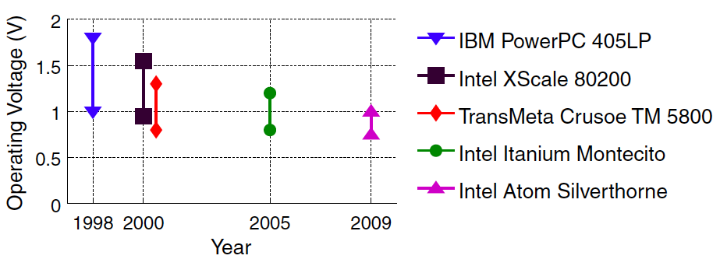
Range of Operational Voltage
[Watanabe et al., ISCA’10]
Shrinking range of operational voltage hampers voltage-freq. scaling
Notes:
The conventional way to be more efficient is dynamic voltage and frequency scaling (DVFS). However, this technique can only lower energy by a few percentage points, and the range on which it operates shrinks in time. Over a 10 year period, the range of operational frequency (normalized difference between Vth and Vdd) dropped by 70%, making DVFS increasingly irrelevant.

Slide 11
Where Does Server Energy Go?
Many sources of power consumption:
Server only [Fan, ISCA’07]
  Processor chips (37%)
  Memory (17%)
  Peripherals (29%)
  …
Infrastructure (another 50%)
  Cooling
  Power distribution

Slide 12
A Study of Server Chip Scalability
Actual server workloads today
  Easily parallelizable (performance-scalable)
Actual physical char. of processors/memory
  ITRS projections for technology nodes
  Modeled power/performance across nodes
For server chips
  Bandwidth is near-term limiter
  → Energy is the ultimate limiter
Notes:
As processor chips consume the majority of server energy, we set out to explore their architecture and scalability. We use actual server workloads, and model actual processors across technologies following ITRS projections. We’ll see that off-chip bandwidth is the near-term limiter. By employing bandwidth-reducing techniques, we can push the bandwidth envelope far enough, at which point energy remains the ultimate limiter.

Slide 13
First-Order Analytical Modeling
[Hardavellas, IEEE Micro 2011]
Physical characteristics modeled after UltraSPARC T2, ARM11
Area: Cores + caches = 72% die, scaled across technologies
Power: ITRS projections of V_{dd}, V_{th}, C_{gate}, I_{sub}, W_{gate}, S₀
  Active: cores=f(GHz), cache=f(access rate), NoC=f(hops)
  Leakage: f(area), f(devices), 66ºC
  Devices/ITRS: Bulk Planar CMOS, UTB-FD SOI, FinFETs, HP/LOP
Bandwidth:
  ITRS projections on I/O pins, off-chip clock, f(miss, GHz)
Performance: CPI model based on miss rate
  Parameters from real server workloads (DB2, Oracle, Apache)
  Cache miss rate model (validated), Amdahl & Myhrvold Laws
Notes:
A few things about the model

Slide 14
Caveats
First-order model
  The intent is to uncover trends relating the effects of technology-driven physical constraints to the performance of commercial workloads running on multicores
  The intent is NOT to offer absolute numbers
Performance model works well for workloads with low MLP
  Database (OLTP, DSS) and web workloads are mostly memory-latency-bound
Workloads are assumed parallel
  Scaling server workloads is reasonable
Notes:
This is a first-order model only, with the intent to uncover trends and not to offer absolute numbers.

Slide 15
Area vs. Power Envelope
Good news: can fit 100’s cores. Bad news: cannot power them all
Notes:
We fix the area and power budget, and calculate the area left over for cores and cache. We draw two lines: the yellow indicates the chip designs where the entire area if filled with cores and cache assuming infinite power; the black shows how many cores and cache we can power together, assuming max clock rate. Good news: can fit 100’s cores. Bad news: cannot power them all. The reason is that we run the chip at max speed, so we require the max supply voltage and so we consume max power. We can relax this requirement and scale the voltage and the frequency together.
DB2-TPCC, GPP, 20nm, conventional memory, HP transistors, 310mm die, 130W power, 10GHz max freq.

Slide 16
Pack More Slower Cores, Cheaper Cache
VFS
The reality of The Power Wall: a power-performance trade-off
Notes:
As the voltage scales down from right to left, we can power an increasingly large chip with more and more cores. However, the speed also scales down from right to left, changing the performance in the opposite direction as each one of the cores now becomes slower. This is the true nature of the power wall: it is a power/performance tradeoff. It is not clear which one is the best design point of all (best = peak performance). But we are not done yet. All these curves assume infinite bandwidth.
DB2-TPCC, GPP, 20nm, conventional memory, HP transistors, 310mm die, 130W power, 10GHz max freq.

Slide 17
Pin Bandwidth Constraint
VFS
Bandwidth constraint favors fewer + slower cores, more cache
Notes:
If we also add the bandwidth constraint, we see that as clock rates increase from top to bottom, we have the bandwidth to support fewer and fewer cores. The feasible designs are the ones below the bandwidth curve for some voltage, and to the left of the power curve for the same voltage. So, which one is the best design now?
DB2-TPCC, GPP, 20nm, conventional memory, HP transistors, 310mm die, 130W power, 10GHz max freq.

Slide 18
Example of Optimization Results
Power + BW: ~5x loss
BW:
~2x loss
  Jointly optimize parameters, subject to constraints, SW trends
  Design is first bandwidth-constrained, then power-constrained
Notes:
What we do with the model to answer this question is to calculate the performance of each design point, and plot it all in a graph. The yellow line assumes fixed 310mm2 area, but infinite bandwidth and power. The black line assumes a finite power, but the chip runs at the max clock rate. The grey line relaxes the clock rate and scales both the voltage and the frequency and plots the highest performance design of all for each cache size. This is equivalent to what VFS could achieve. The grey line assumes infinite bandwidth, We add the curve that shows the bandwidth constraint, and again plot for each cache size the max performance among all VFS’ed designs (blue). The pareto-frontier of the feasible designs is shown in red. The peak performance is achieved at the intersection of the bandwidth and power constraints.
TPCH, GPP, 20nm, 3D memory, HP transistors, 310mm die, 130W power, 10GHz max freq.

Slide 19
Core Counts for Peak-Performance Designs
Physical characteristics
modeled after
UltraSPARC T2 (GPP)
ARM11 (EMB)
  Designs > 120 cores impractical for general-purpose server apps
  B/W and power envelopes + dataset scaling limit core counts
Notes:
We run this analysis on all workloads across technologies, and we plot the number of cores that the highest-performance design has for each technology node. We show the results for both conventional cores (modeled after UlraSparc T2), and for low-power embedded ones (EMB) modeled after ARM11. We see that while we can feet 1000s of cores in a die, it makes sense to power only a few tens to low hundreds The power consumption of more cores will force the entire chip to run at a lower voltage, slowing down the entire chip and negatively impacting performance. Besides the relative low core counts, we also find that cache sizes grow enormously to mitigate the pin bandwidth wall.

Slide 20
Short-Term Scaling Implications
Caches are getting huge
Need cache architectures to deal with >> MB
Elastic Caches
  Adapt behavior to executing workload to minimize transfers
  Reactive NUCA [Hardavellas, ISCA 2009][Hardavellas, IEEE Micro 2010]
  Dynamic Directories [Das, NUTR 2010, in submission]
      …but that’s another talk…
Need to push back the bandwidth wall!!!
Notes:
So, in the near term we need cache architectures that can deal with multi-megabyte caches. We have done some work in the area, but this is the subject of another talk. What is important to realize here is that we need techniques to push back the bandwidth wall. There is only that much space we can devote to a cache. We can do what humans do when they run out of space in a megacity: they grow vertically and build skyscrapers.

Slide 21
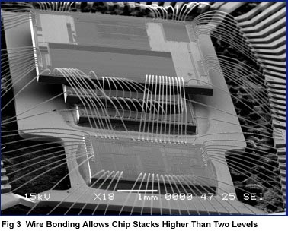
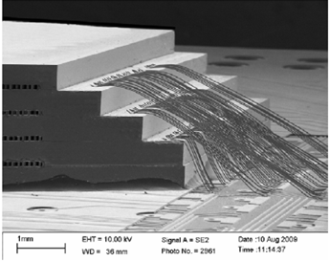
Mitigating Bandwidth Limitations: 3D-stacking
[Philips]
[Loh et al., ISCA’08]
[IBM]
Delivers TB/sec of bandwidth; use as large “in-package” cache
Notes:
So, enter 3D-die stacking. We can put memory on separate dies on top of the logic die with the cores. The memory can be treated as a huge cache which will have such a high hit rate that the pin bandwidth suffices. The connections within the chip are fast and power efficient, as the signal only has to travel a few microns across layers. The internal buses provide TB/s bandwidth in a very small area, easily matching the bandwidth most applications will require.

Slide 22
Performance Analysis of 3D-Stacked Multicores
Chip becomes power-constrained
Notes:
3D-memories effectively push the bandwidth wall beyond the power one, and chips become entirely power constrained.
TPCH, GPP, 20nm, 3D memory, HP transistors, 310mm die, 130W power, 10GHz max freq.

Slide 23
The Rise of Dark Silicon
Transistor counts increase exponentially, but…
Can no longer power the entire chip
(voltages, cooling do not scale)
Traditional HW power-aware
techniques inadequate
(e.g., voltage-freq. scaling)
[Watanabe et al., ISCA’10]
Dark Silicon !!!
Notes:
This power constraint is the one we cannot seem to avoid and ultimately leads to dark silicon. Supply voltages do not scale fast enough, while cooling does not scale at all, and other techniques have diminishing returns, so soon we’ll be able to build dense devices that we cannot afford to power.

Slide 24
Exponentially-Large Area Left Unutilized
Should we waste it?
Notes:
The dark silicon area grows exponentially in time, as shown by the trend line. Here we plot the die size of the peak-performance design for each workload, So instead of having a large chip and use it all (click), we are forced to power down the majority of it and use only a fraction of the available transistors (click). Independent estimates indicate that as soon as next year we’ll have 20% of a chip being dark silicon.

Slide 25
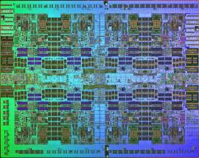
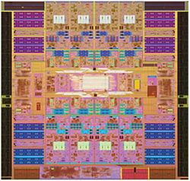
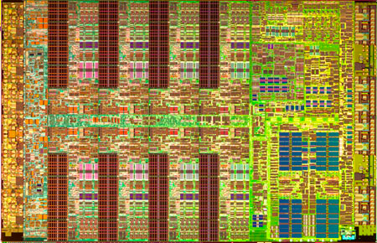
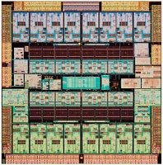
Repurpose Dark Silicon for Specialized Cores
[Hardavellas, IEEE Micro 2011]
Don’t waste it; harness it instead!
  Use dark silicon to implement specialized cores
Applications cherry-pick few cores, rest of chip is powered off
Vast unused area → many cores → likely to find good matches
Notes:
Instead of wasting it, we advocate we should embrace dark silicon and use it to build specialized cores. Instead of powering up a small number of identical cores (click), the applications will cherry-pick the cores that most closely match their computational requirements. The vast and exponentially growing area of dark silicon allows us to implement a wide variety of specialized cores, increasing the likelihood that an application will find a good match. Why specialized cores are ay better than conventional ones?

Slide 26
Overheads of General-Purpose Processors
2000pJ
50pJ
Core specialization will minimize most overheads
ASICs ~100-700x more efficient than general-purpose cores
Notes:
Because they eliminate overheads. Here we show typical energy numbers for various operations. A FP multiplication for example consumes 50pJ; yet the processor consumes 2000pJ to prepare its execution. Similarly, an integer ADD consumes 0.5pJ, but we still have to suffer the 2000pJ to to prepare it for execution. Data transfers is another major energy drain. Accessing data from local memories is only 50pJ, while getting them from a far away L2 slice is 256-1000pJ, and getting them from main memory requires ~16000 pJ. These overheads are there mostly to support general-purpose computing; a carefully designed specialized core should avoid most of them. As a matter of comparison, ASICs are 100-700x more energy-efficient that conventional cores. So, we set to evaluate the impact of specialized cores in our model.

Slide 27
First-Order Core Specialization Model
Modeling of physically-constrained CMPs across technologies
Model of specialized cores based on ASIC implementation of H.264:
  Implementations on custom HW (ASICs), FPGAs, multicores (CMP)
  Wide range of computational motifs, extensively studied
 |  | Frames per sec | Energy per frame (mJ) | Performance gap of CMP vs. ASIC | Energy gap of CMP vs. ASIC
ASIC |  | 30 | 4
CMP | IME | 0.06 | 1179 | 525x | 707x
 | FME | 0.08 | 921 | 342x | 468x
 | Intra | 0.48 | 137 | 63x | 157x
 | CABAC | 1.82 | 39 | 17x | 261x
[Hameed et al., ISCA 2010]
12x LOWER ENERGY compared to best conventional alternative
Notes:
We build our specialized cores by looking at published numbers for H.264, a high-definition video encoder. We choose H.264 because it has been widely studied, and optimized implementations exist for pretty much anything, conventional multicores, FPGAs, ASICs, etc. H.264 has a wide range of computational motifs, from data parallel ones (motion estimation) to control intensive ones (CABAC segment). We model our specialized cores by looking at the worst case scenario: the control-intensive CABAC segment is the least hardware-friendly, due to the large number of changes in control flow (if-then-else statements). By running our models again, assuming our cores exhibit characteristics similar to an ASIC implementation of CABAC, we find that we can obtain a 12x redution in energy compared to the best alternative!!!!

Slide 28
Specialized Multicores: Power Only Few Cores
Only few cores need to run at a time for max speedup
Vast unused die area will allow many cores
Notes:
And the interesting thing is that this performance is achieved by using only a small number of cores, an order of magnitude less that used by conventional designs. So, only a few specialized cores need to be powered up to achieve peak performance. The remaining area can be used to implement a wide range of cores with different functionality.

Slide 29
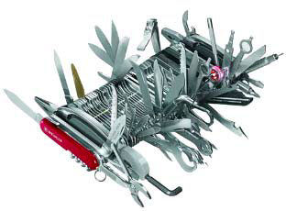

The New Core Design
[analogy by A. Chien]
From fat conventional cores, to a sea of specialized cores
Notes:
So, cores are moving from big beasts able to do everything but excelling at nothing, to a sea of specialized cores, each able to do only a small number of jobs but can do them really well.

Slide 30
The New Multicore
Power up only what you need
Notes:
Instead of building multicores out of conventional cores, we build a sea of specialized ones, where the application powers up only what it needs, leaving the rest of the chip off to conserve energy.

Slide 31
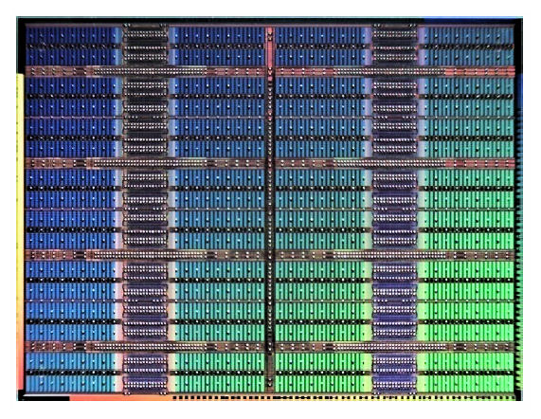
The New Multicore Node
3D-stacked
memory (cache)
cores
Note: can push further with more exotic technologies
(e.g., nanophotonics) …but that’s another talk
Specialized cores + 3D-die memory stacking
Notes:
Ideally, each of these multicore chips will have 3d-stacked memory, to minimize the pin bandwidth demands.

Slide 32
Design for Dark Silicon: Many Open Questions
To get 12x lower energy (12x performance for same power budget):
Which candidates are best for off-loading to specialized cores?
What should these cores look like?
  Exploit commonalities to avoid core over-specialization
  Can we classify all computations into N bins (for a small N)?
What are the appropriate language/compiler/runtime techniques to drive execution migration?
  Impact on scheduler?
How to restructure software/algorithms for heterogeneity?
Notes:
But, to get the 12x that specialize computing promises, …

Slide 33
Thank You!
Questions?
References:
N. Hardavellas, M. Ferdman, B. Falsafi, and A. Ailamaki. Toward Dark Silicon in Servers. IEEE Micro, Vol. 31, No. 4, July/August 2011.
N. Hardavellas. Chip multiprocessors for server workloads. PhD thesis, Carnegie Mellon University, Dept. of Computer Science, August 2009.
N. Hardavellas, M. Ferdman, A. Ailamaki, and B. Falsafi. Power scaling: the ultimate obstacle to 1K-core chips. Technical Report NWU-EECS-10-05, Northwestern University, Evanston, IL, March 2010.
R. Hameed, W. Qadeer, M. Wachs, O. Azizi, A. Solomatnikov, B. C. Lee, S. Richardson, C. Kozyrakis, and M. Horowitz. Understanding sources of inefficiency in general-purpose chips. In Proc. of ISCA, June 2010.
If you want to know more about my “other talks” come find me at the break!

