Slide 1
Exploiting Dark Silicon for Energy Efficiency
Nikos Hardavellas
Northwestern University, EECS

Slide 2
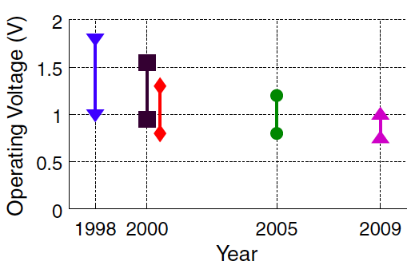
Technology Scaling Changes the HW Landscape
Transistor counts increase exponentially, but…
Can no longer power the entire chip
(voltages, cooling do not scale)
Traditional HW power-aware
techniques inadequate
(e.g., voltage-freq. scaling)
[Watanabe et al., ISCA’10]
Dark Silicon !!!

Slide 3
The Rise of Dark Silicon
Exponentially-large area is left unutilized (dark). Should we waste it?

Slide 4
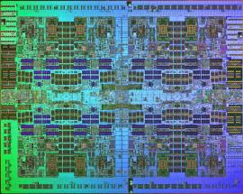
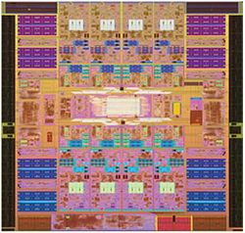
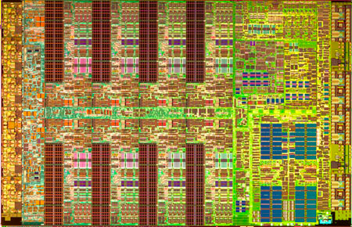
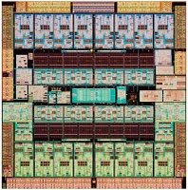
Design for Dark Silicon
Don’t waste it; harness it instead!
  Use dark silicon to implement specialized cores
Applications cherry-pick few cores, rest of chip is powered off
Vast unused area → many cores → likely to find good matches

Slide 5
First-Order Core Specialization Model
Modeling of physically-constrained CMPs across technologies
Model of specialized cores based on ASIC implementation of H.264:
  Implementations on custom HW (ASICs), FPGAs, multicores (CMP)
  Wide range of computational motifs, extensively studied
 |  | Frames per sec | Energy per frame (mJ) | Performance gap of CMP vs. ASIC | Energy gap of CMP vs. ASIC
ASIC |  | 30 | 4
CMP | IME | 0.06 | 1179 | 525x | 707x
 | FME | 0.08 | 921 | 342x | 468x
 | Intra | 0.48 | 137 | 63x | 157x
 | CABAC | 1.82 | 39 | 17x | 261x
[Hameed et al., ISCA’10]
12x LOWER ENERGY compared to best conventional alternative

Slide 6
Research Directions
Which candidates are best for off-loading to specialized cores?
What should these cores look like?
  Exploit commonalities to avoid core over-specialization
  Impact on ISA?
What are the appropriate language/compiler/runtime techniques to drive execution migration?
  Impact on scheduler?
How to restructure software/algorithms for heterogeneity?

Slide 7
Thank You!
Questions?
References:
N. Hardavellas, M. Ferdman, B. Falsafi, and A. Ailamaki. Toward Dark Silicon in Servers. IEEE Micro, Vol. 31, No. 4, July/August 2011.
N. Hardavellas. Chip multiprocessors for server workloads. PhD thesis, Carnegie Mellon University, Dept. of Computer Science, August 2009.
N. Hardavellas, M. Ferdman, A. Ailamaki, and B. Falsafi. Power scaling: the ultimate obstacle to 1K-core chips. Technical Report NWU-EECS-10-05, Northwestern University, Evanston, IL, March 2010.
R. Hameed, W. Qadeer, M. Wachs, O. Azizi, A. Solomatnikov, B. C. Lee, S. Richardson, C. Kozyrakis, and M. Horowitz. Understanding sources of inefficiency in general-purpose chips. In Proc. of ISCA, June 2010.
E. S. Chung, P. A. Milder, J. C. Hoe, and K. Mai. Single-chip heterogeneous computing: does the future include custom logic, FPGAs, and GPGPUs? In Proc. of MICRO, December 2010.

